Slide 1
Mass Relationships
in Chemical Reactions
Dr. Sultana Bedoura
Chapter 3

Slide 2
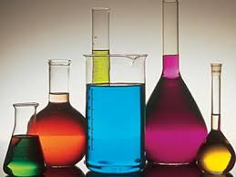

Outline
Atomic mass
Avogadro’s number
Molar mass
Molecular mass
The Mass Spectrometer
Percent composition of compounds
Molecular and empirical formulas
Chemical reaction and equation
Amounts of reactants and products
Limiting reagents and reaction yield

Slide 3
Atomic mass
Mass of an atom, depends on the number of subatomic particles
Exact weight measurement of sub atomic particles are not possible.
Need a standard value to measure
amu (atomic mass units) is that standard value which is defines as –
“a mass exactly equal to one-twelfth the mass of one carbon-12 atom”
Atomic mass is the mass of an atom in atomic mass unit (amu)
On this scale, ¹H = 1.008 amu
¹⁶0 = 16.000 amu
By definition
1 atom ¹²C “weighs” 12 amu

Slide 4
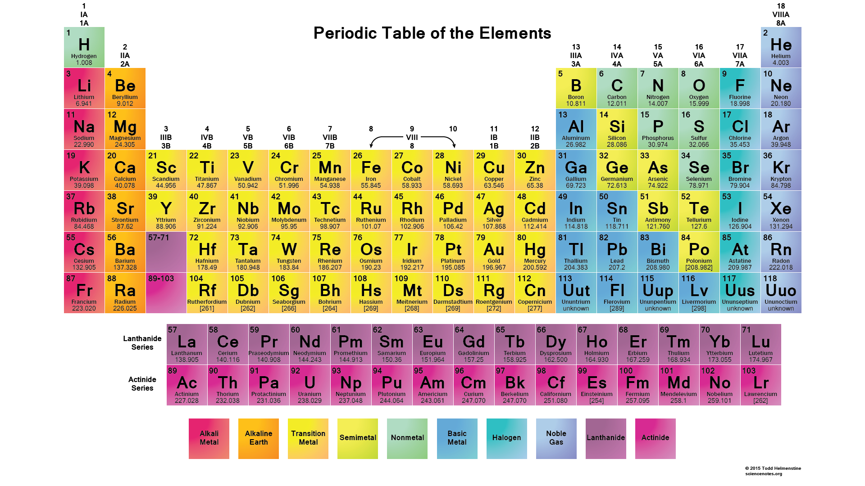
average Atomic mass
Why C has atomic mass 12. 01 amu instead of 12.00 amu?
The reason for the difference is that most naturally occurring elements (including carbon) have more than one isotope
The average atomic mass is the weighted average of all of the
naturally occurring isotopes of the element
Average atomic mass of C:
Average atomic mass
C isotopes | Natural abundance (%) | Atomic mass (amu)
¹² C | 98.90 | 12.00000
¹³C | 1.10 | 13.00335
98.90 x 12.00000 + 1.10 x 13.00225
= 12.011 amu
100

Slide 5
Avogadro’s Number
The mole: A unit to count numbers of particles
Like
The mole (mol) is the amount of substance that contains as elementary entities as there are atoms in exactly 12.00 grams of ¹²C.
1 mol = N_{A} = 6.0221367 X 10²³
Avogadro’s number (N_{A})
Dozen = 12
Pair = 2

Slide 6
Molar mass
Molar mass is the mass of 1 mol of X in grams
Molar mass is exactly same as the atomic mass
but in grams/ kg, not in amu
1 mol ¹²C atoms = 6.022 X 10²³ atoms = 12.00 g
1 ¹²C atom = 12.00 amu
1 mol ¹²C atoms = 12.00 g ¹²C
1 mol lithium atom = 6.941 g of Li
For any element
Atomic mass (amu) = molar mass (grams)

Slide 7
Calculating the mass of atom in grams
Knowing the molar mass and Avogadro’s number, we can calculate the mass of a single atom in grams.
Example:
We know,
1 mol ¹²C atoms = 6.022 X 10²³ atoms
1 mol ¹²C atoms = 12.00 g ¹²C
The mass of one ¹²C atom is given by,
12.00 g ¹²C atoms
6.022 X 1023 ¹²C atoms
= 1.993 X 10⁻²³ g

Slide 8
Relationship between amu & gram
m/M
nN_{A}
Mass of element (m)
Number of moles of element (n)
Number of atoms of element (N)
n M
N/N_{A}
M = molar mass in g/mol
N_{A} = Avogadro’s number = 6.0221367 X 10²³
1 ¹²C atom x
12.00 g
1.66 x 10⁻²⁴ g
=
12.00 amu x
6.022 x 10²³ ¹²C atoms
1 amu
1 amu = 1.66 x 10⁻²⁴ g
or 1 g = 6.022 x 10²³ amu

Slide 9
How many atoms are in 0.551 g of potassium (K) ?
1 mol K = 39.10 g K
1 mol K = 6.022 x 10²³ atoms K
1 mol K
6.022 x 10²³ atoms K
0.551 g K
x
x
39.10 g K
1 mol K
= 8.49 x 10²¹ atoms K

Slide 10
Tasks
How many moles of He atoms are in 6.46 g of He?
[ 1 mol He = 4.003 g He]
What is the mass in grams of 13.2 amu?
How many atoms are there in 5.10 moles of sulfur(S)?
[ 1 mol S = 32.06 g S]
How many grams of gold (Au) are there in 15.3 moles of Au?
[ 1 mol Au =197.0 g Au]
ans: 1 .61 mol He atoms
ans: 2.19 × 10⁻²³ g
ans: 3.07 × 10²⁴ S atoms
ans: 3.01 × 10³ g Au

Slide 11
Molecular Mass
Molecular mass (or molecular weight) is the sum of the atomic masses (in amu) in a molecule.
1S 32.07 amu
2O + 2 x 16.00 amu
SO₂ 64.07 amu
For any molecule
Molecular mass (amu) = molar mass (grams)
1 molecule SO₂ = 64.07 amu
A mol SO₂ = 64.07 g SO₂

Slide 12
How many H atoms are in 72.5 g of C₃H₈O ?
1 mol C₃H₈O = (3 x 12) + (8 x 1) + 16 = 60 g C₃H₈O
1 mol C₃H₈O molecules = 8 mol H atoms
1 mol H = 6.022 x 10²³ atoms H
1 mol C₃H₈O
8 mol H atoms
6.022 x 10²³ H atoms
∴72.5 g C₃H₈O
x
x
x
60 g C₃H₈O
1 mol C₃H₈O
1 mol H atoms
= 5.82 x 10²⁴ atoms H

Slide 13
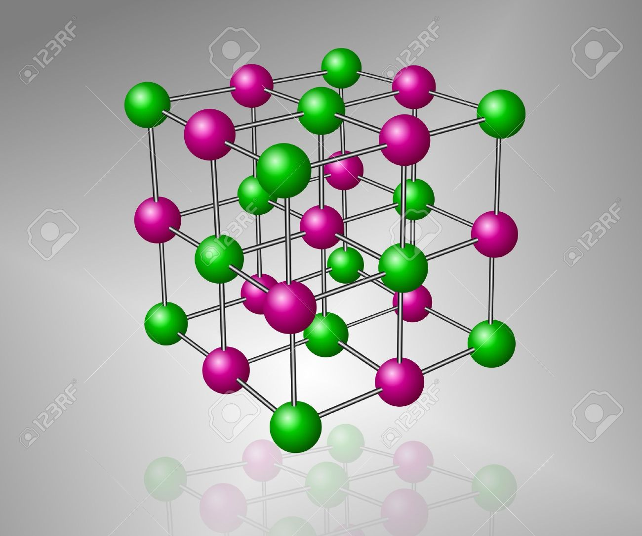
formula mass
Formula mass is the sum of the atomic masses (in amu) in a formula unit of an ionic compound
For any ionic compound
formula mass (amu) = molar mass (grams)
1 formula unit NaCl = 58.44 amu
1 mole NaCl = 58.44 g NaCl
1Na
22.99 amu
1Cl
+ 35.45 amu
NaCl
58.44 amu

Slide 14
What is the formula mass of Ca₃(PO₄)₂ ?
1 formula unit of Ca₃(PO₄)₂
3 Ca
3 x 40.08
2 P
2 x 30.97
8 O
+ 8 x 16.00
310.18 amu

Slide 15
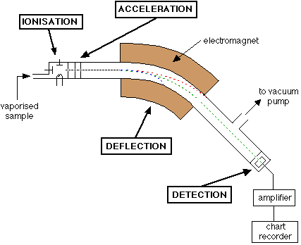
Mass Spectrometer
Stage 1: Ionisation
The atom or molecule is ionized by
knocking one or more electrons off to
give a positive ion
Stage 2: Acceleration
The ions are accelerated so that they have the
same kinetic energy
Stage 3: Deflection
The ions are deflected by magnetic field according to their masses
Stage 4: Detection
The beam of ions passing through the machine is detected electrically

Slide 16
Percent Composition of Compounds
Percent composition of an element in a compound =
n x molar mass of element
x 100%
molar mass of compound
n is the number of moles of the element in 1 mole of the compound
2 x (12.01 g)
%C =
x 100% = 52.14%
46.07 g
6 x (1.008 g)
%H =
x 100% = 13.13%
46.07 g
1 x (16.00 g)
%O =
x 100% = 34.73%
46.07 g
C₂H₆O
52.14% + 13.13% + 34.73% = 100.0%

Slide 17
Percent Composition and Empirical Formulas
Mass present
Determine the empirical formula of a compound that has the following percent composition by mass:K 24.75, Mn 34.77, O 40.51 percent.
Convert to grams and
divide by molar mass
Moles of each element
1 mol K
Divide by the smallest
number of moles
n_{K} = 24.75 g K x
= 0.6330 mol K
39.10 g K
Mole ratios of elements
1 mol Mn
n_{Mn} = 34.77 g Mn x
= 0.6329 mol Mn
54.94 g Mn
Change to integer
subscript
1 mol O
Empirical formula
n_{O} = 40.51 g O x
= 2.532 mol O
16.00 g O

Slide 18
Continuing
Mass present
n_{K} = 0.6330, n_{Mn} = 0.6329, n_{O} = 2.532
Convert to grams and
divide by molar mass
Moles of each element
0.6330
K :
~
1.0
~
0.6329
Divide by the smallest
number of moles
0.6329
Mn :
= 1.0
0.6329
Mole ratios of elements
2.532
O :
~
4.0
~
0.6329
Change to integer
subscript
Empirical formula
Answer : KMnO₄

Slide 19
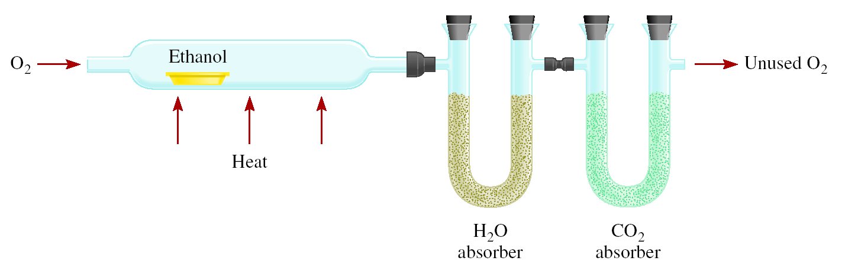
Experimental Determination of Empirical Formulas
O₂
Unused O₂
_{Heat}
Combust 11.5 g ethanol
Collect 22.0 g CO₂ and 13.5 g H₂O
H₂O
_{absorber}
CO₂
_{absorber}
11.5 g of sample
g CO₂
mol CO₂
mol C
g C
6.0 g C = 0.5 mol C
g H₂O
mol H₂O
mol H
g H
1.5 g H = 1.5 mol H
g of O = g of sample – (g of C + g of H)
4.0 g O = 0.25 mol O
Empirical formula C_{0.5}H_{1.5}O_{0.25}
Divide by smallest subscript (0.25)
Empirical formula C₂H₆O

Slide 20
Determination of Molecular Formulas
The steps are:
Calculate empirical molar mass
Molar mass is known
Divide molar mass by empirical molar mass
It is a simple integer
Multiply the subscripts of empirical formula with the result

Slide 21
Determination of Molecular Formulas
Hydrogen per oxide has an empirical formula of HO. What is the molecular formula?
Given the molar mass of hydrogen per oxide is 32.02g.
Empirical molar mass of HO= (1.008+16)g
= 17.008 g
Molar mass
32.02g
=
=
1.88 ~ 2
Empirical molar mass
17.008g
Molecular formula of HO = (HO) ₂ = H₂O₂

Slide 22
Chemical reaction & chemical equations
A chemical reaction is a process in which one or more substances is changed into one or more new substances.
A chemical equation uses chemical symbols to show what happens during a chemical reaction.
Reactants Products
Example : H₂ gas burns in air (which contains O₂) to form H₂O
3 ways of representing the above reaction
+
Two hydrogen + One oxygen Two water
molecules molecule molecules
2H₂ + O₂ 2H₂O

Slide 23
How to read chemical equations
2 Mg + O₂ 2 MgO
2 atoms Mg + 1 molecule O₂ makes 2 formula units MgO
2 moles Mg + 1 mole O₂ makes 2 moles MgO
48.6 grams Mg + 32.0 grams O₂ makes 80.6 g MgO
NOT
2 grams Mg + 1 gram O₂ makes 2 g MgO

Slide 24
Balancing Chemical Equations
Write the correct formula (s) for the reactants on the left side and the correct formula (s) for the product(s) on the right side of the equation.
Change the numbers in front of the formulas (coefficients) to make the number of atoms of each element the same on both sides of the equation. Do not change the subscript.
Start by balancing those elements that appear in only one reactant and one product.
Balance those elements that appear in two or more reactants or products.
Check to make sure that you have the same number of each type of atom on both sides of the equation.

Slide 25
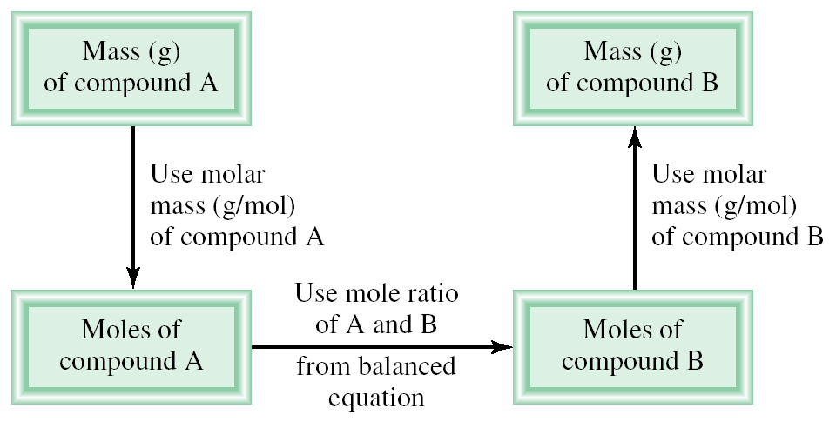
Amounts of Reactants and Products
Write balanced chemical equation.
Convert quantities of known substances into moles.
Use coefficients in balanced equation to calculate the number of moles of the sought quantity.
Convert moles of sought quantity into desired units.

Slide 26
Methanol burns in air according to the equation
2CH₃OH + 3O₂ 2CO₂ + 4H₂O
If 209 g of methanol are used up in the combustion, what mass of water is produced?
2CH₃OH + 3O₂ 2CO₂ + 4H₂O
Given mass : 209 g ?g
Molar mass : 12+3+16+1 = 32 g 2+ 16 =18 g
Mole : 209/ 32 = 6.53 mole
2 mole CH₃OH reacts to form = 4 mole H₂O
1 mole CH₃OH reacts to form = 4/2 mole H₂O
6.53 mole CH₃OH reacts to form = mole H₂O =13.06 mole H₂O
= (13.06 x 18) g H₂O = 235 g H₂O
4 x 6.53
2

Slide 27
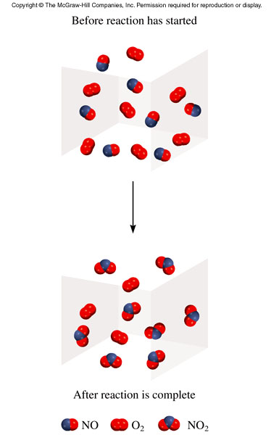
Limiting reagents
Limiting reagent : the reactant used up first in a reaction
because the maximum amount of product formed depends on how much of this reactant was originally present
Excess reagents : the reactants present in quantities greater than necessary to react with the quantity of the limiting reagent
2NO + O₂ 2NO₂
NO is the limiting reagent
O₂ is the excess reagent

Slide 28
In one process, 124 g of Al are reacted with 601 g of Fe₂O₃
2Al + Fe₂O₃ Al₂O₃ + 2Fe;
a) Calculate the mass of Al₂O₃ formed.
b) Which one is the limiting reagent?
c)What will be the amount (in mole)of excess reagent remaining at the end of the reaction?
2Al + Fe₂O₃ Al₂O₃ + 2Fe
Molar mass : 27 160 102
Given amount: 124 g 601g ? g
Mole : 124/ 27) (601/160)
= 4.59 mole = 3.76 mole
With Al : With Fe₂O₃ :
2 mole of Al reacts to form 1 mole of Al₂O₃
1 mole of Al reacts to form = mole of Al₂O₃
4.59 mole Al reacts to form = mole of Al₂O₃
1 mole of Fe₂O₃ reacts to form 1 mole of Al₂O₃
3.76 mole of Fe₂O₃ reacts to form = 3.76 x 1
1
2
1 x 4.59
= 3.76 mole of Al₂O₃
2
= 2.30 mole of Al₂O₃
a) Mass of Al₂O₃ formed = (2.30 x 102 ) = 234.6 g [ Molar mass of Al₂O₃ = 102 g]
b) Have more Al₂O₃ with given amount of Fe₂O_{3 .}As Fe₂O₃ remains in excess, so, Al is limiting reagent.
c) Reacted Fe₂O₃ =2.3 mole (as mole of Fe₂O₃ =mole of Al₂O₃). So, Unreacted Fe₂O₃ = (3.76-2.30)= 1.46 mole Fe₂O₃

Slide 29
REACTION YIELD
Theoretical Yield: the amount of product that would result if all the limiting reagent reacted
Actual Yield: the amount of product actually obtained from a reaction
Reaction Yield: the proportion of the actual yield to the theoretical yield
Actual Yield
% Yield =
x 100%
Theoretical Yield

Slide 30
Thank you

